Slide 1
Taxes in Finland

Slide 2
Keywords
Taxes — payments you must make to the government to finance welfare services.
Withholding rate — the part of your wages that your employer withholds from your pay, and sends on to the Finnish Tax Administration.
Finnish Tax Administration — the organisation that gathers the payments and gives advice on tax questions.

Slide 3
Keywords (continued)
Pre-completed tax return — a report with information on your income and deductions during the year.
Tax decision — the result of the calculation of your income, tax, and deductions for the year. You may get money back (a refund), or you may have to pay more (back taxes).
Earned income — your pay, wages, salary etc.
Progressive taxation — the rule that makes the tax rate higher when the income is higher.

Slide 4
How is the money used?
With tax money, Finland pays for:
health care and medical care
schools
children's daycare
higher education
national defence
facilities for sports, arts and hobbies.

Slide 5
You are a taxpayer, too:
When you buy something, prices include Value-Added-Tax (VAT).
You pay income tax when you work and get paid.
You also pay income tax for:
Students' grant income
Pension income
Unemployment allowance
Business income.
If you get rental income and if you get dividends, you pay income tax on capital income.
p
Notes:
Makeisvero: Verotuksella pyritään ohjaamaan kuluttajien käyttäytymistä. Ylimääräisellä verolla halutaan vähentää tuotteen ostamista ja samalla kerätä lisää verotuloja. Muita kulutusta ohjaavia veroja: Alkoholivero, tupakkavero, polttoainevero

Slide 6
Tax Calendar
January: You get a new tax card.
You get income during the year, and part of it is paid in (tax withholding).
2016
2017
April:
You get a Pre-completed
tax return – check it and make corrections, if necessary.
September and October:
You get a new Tax Decision if you made corrections
in April.
December:
You may get a refund OR you may have to pay back taxes.

Slide 7
Tax cards
2016
Everyone must have a tax card (for receiving wages or other income).
It has the withholding rate printed on it. This tells your employer how much to withhold.
Your get a new tax card sent to you every year in January.

Slide 8
Tax cards (continued)
2016
Ask for a new tax card if your income changes during the year.
Tax Card Online (tax.fi/taxcard)
Telephone Service on 029 497 000.
Visit any Tax Office.

Slide 9
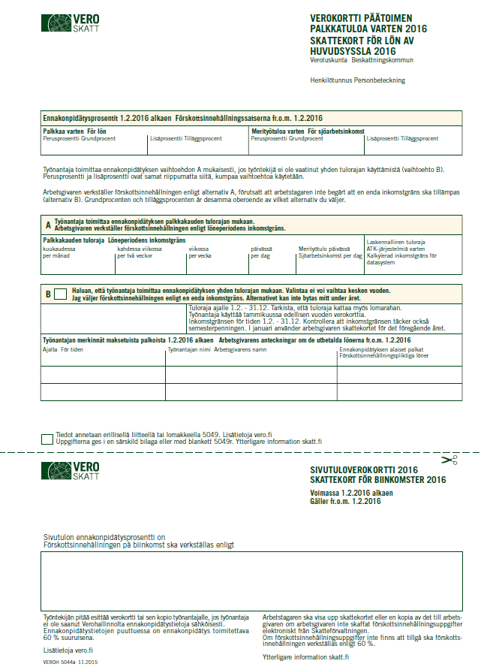
The tax card looks like this:
If your wages are higher than your income limit, your employer must withhold this much.
The withholding rate
= how much money your employer withholds.
If you have a second job or jobs, you need this part of the tax card.

Slide 10
Pre-completed tax return
2017
You get a pre-completed tax return every year, in spring. We send it by post.
It shows your income and deductions as we know them.
It also shows a first calculation of your taxes for the year: will you get a refund, or will you have to pay more.

Slide 11
Pre-completed tax return
2017
You must check the information.
If any of the details are wrong, make corrections and send them to us.
If the information is correct, you don't have to do anything.

Slide 12
The return looks like this:
Your last date for corrections.
Pre-completed amounts
Fill in the white columns if you make corrections.

Slide 13
Tax Return on the Web
Log in to make corrections
Tax Return on the Web (vero.fi/veroilmoitus)
The last date to make corrections is the date printed on your paper return form.
Run the Demo version to practice
Demo

Slide 14
Tax decision
2017
The Pre-completed tax return is enclosed with a Tax decision (first version).
If there is no need to make corrections, the first version becomes the final version.
If you make corrections, a new Tax decision is sent to you in the autumn.
Tax decision shows you: will you get money back, or will you have to pay more.
Keep the papers.

Slide 15
About Refunds and Back Taxes
2017
If you overpaid tax during the year, you will receive a refund in December the following year.
Make an online bank account number notice for refunds (vero.fi/tilinumero)
If you paid too little, you must pay more in December the following year (back tax).
The bank transfer forms are sent to you together with your Tax decision.

Slide 16
Taxes can be reduced by deductions
You may ask for deductions which reduce the tax you have to pay.
Some deductions are automatically calculated by the Tax Office.

Slide 17
Taxes can be reduced by deductions
Travel expenses give you a deduction, but you must ask for it.
We recommend that you inform us about your deductions. Do this when you check your tax return or ask for a new tax card.
More about deductions (www.tax.fi)

